Slide 1

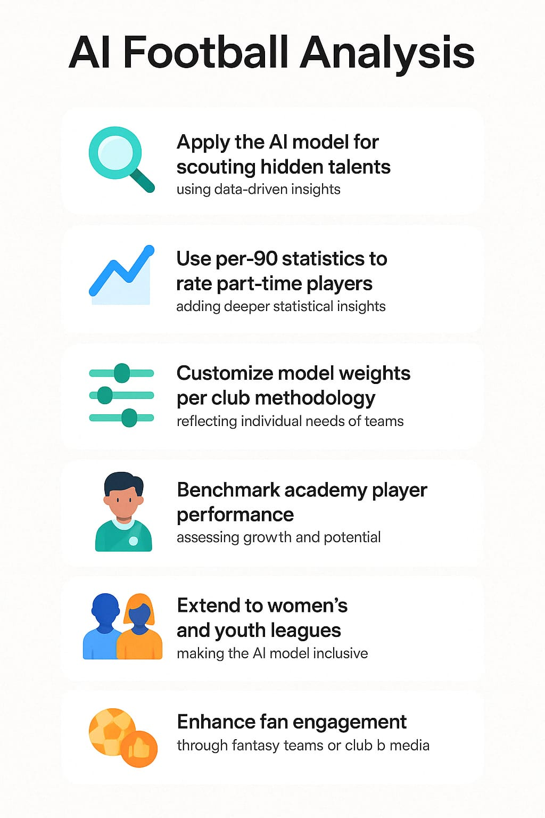
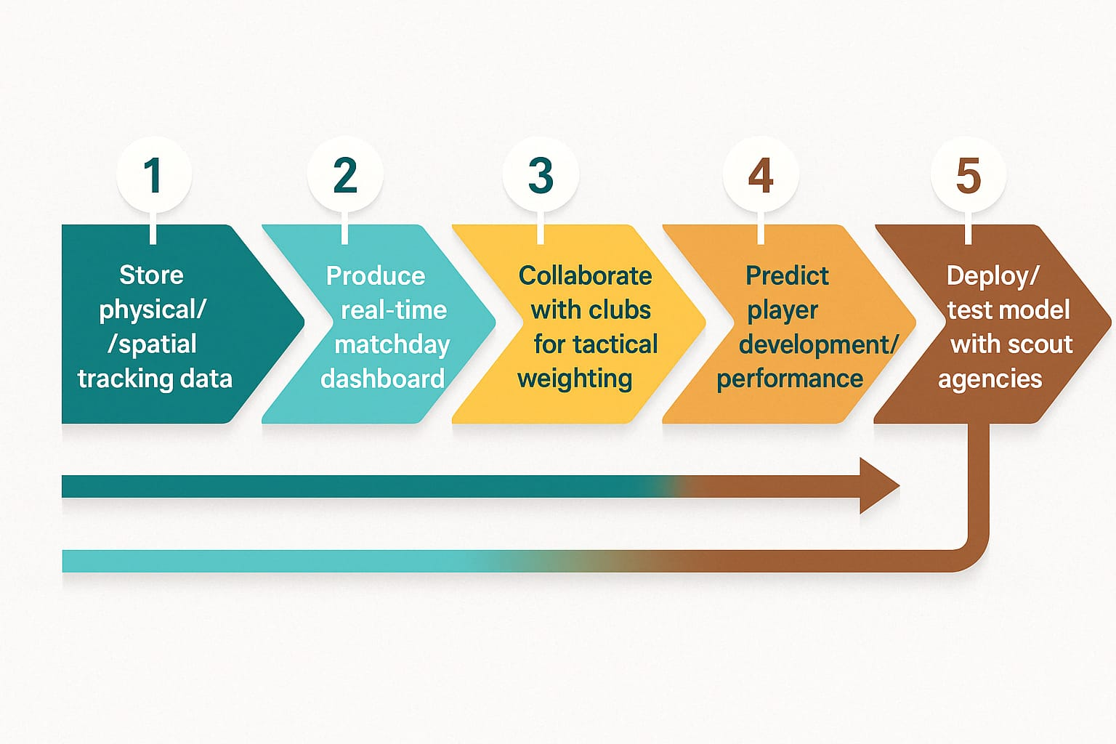
GROUP 4
AI FOOTBALL ANALYSIS
Rakshith Ravichandran, Sabeel Ahmed, Sanjay Sajith Kandirickal, Eldhose Paul, Shanjai Chinnamma Reddy, Sanket Anil Mistry
School of Business
INTRODUCTION
Modern Football clubs are embracing sophisticated analytics to gain a competitive edge in scouting, assessing players' performance, and tactical planning. With every match providing a profusion of data, our project builds a role-based model for analyzing defenders, midfielders, strikers, and goalkeepers by using per-90-minute statistics. Traditional stats have the tendency of breaking down in assessing key players—this model bridges such knowledge gaps by establishing composite scores to gauge player efficiency, all-aroundness, and effectiveness.
The ultimate goal: arm clubs with a healthy, flexible, and scalable system to make wiser decisions on and off the field.
RESULTS
Midfielder: Rabby Nzingoula and Edoardo Bove excelled in defensive midfield positions with great tackling and interception percentages.
Forwards: Thomas Cannon was a high-potential forward with no goals, registering exceptional shot-on-target frequency.
Defenders: Alessandro Dellavalle's rating of 2169 significantly outstripped league performances, highlighting him as one of the best defenders.
Goalkeepers: Joel Robles and Ivan Zlobin displayed an untypical balance of solid percentages on saves with efficient passing.
Analysis facilitated identifying low-priced, high-quality players—to whom cost-conscious clubs had to try harder.
OBJECTIVES
Build a position-based, machine scoring model from football data.
Standardize performance statistics to per-90-minute rates for comparability.
Pinpoint underappreciated or ignored players using statistical analysis.
Support data-driven recruitment, team rotation, and offer letters.
Quantify the relative effect of players across leagues with percentile metrics.
Deliver visualization-ready analysis to coaches, analysts, and journalists.
RECOMMENDATIONS
Apply the scoring model to club scouting departments to find hidden gems.
Use per-90 stats to fairly rate substitutes or players who play fewer than 90 minutes.
Tailor metric weighting according to club methodology (e.g., pressing or possession).
Use this model for junior academy performance benchmarking.
Use the scoring framework on women's leagues and junior tournaments.
Tap into fan engagement metrics through club media and fantasy football integration..
DATA
Source: Data of player performance was collected from publicly accessible football statistics databases of the top 5 European leagues for the season 2024-2025.
Scope: The data included both offense and defense plays for over 500 players in four categories- Goalkeepers, Defenders, Midfielders, and Forwards.
Features: The key statistics pulled out are:
Midfielders: Assists, Interceptions, Tackles Won, Through Balls
Forwards: Goals, Assists, Shots on Target
Defenders: Interceptions, Tackles, Clearances, Aerial Duels, Blocks
Goalkeepers: PSxG +/-, Save %, Clean Sheets, Sweeper Actions, Passing Accuracy
Normalization: All statistics were normalized to per-90-minute measures to mitigate biases based on disparate game time.
Quality Checks: Minute-insufficient players were excluded in order to maintain statistical significance throughout rankings.
Output: Clean data and organization allowed for easy composite scores by player construction to support proper comparisons as well as visualization.
NEXT STEP
Store physical and spatial tracking data for dynamic analysis.
Produce a matchday real-time dashboard for analysis and coaching staff.
Collaborate with clubs to fine-tune metric weighting according to tactical needs.
Examine predictive analytics to predict forthcoming player development or performance.
Cooperate with scout agencies to deploy and test model performance in genuine transfers.
METHODOLOGY
Data Collection: Ripped player data from European upper-tier leagues. Standardization: All statistics standardised to per-90 statistics to maintain justice across different amounts of play time.
Score Formulas:
Midfielders: Highlighted through balls,interceptions, tackles and assists.
Forwards: Target-focused priorities, aid, and on-target strikes.
Defenders: Clearances, Save, aerial fight, and interception.
Goalkeepers: Aggregate PSxG, Save%, Clean Sheets, and Sweeping.
Scoring Logic: Weighted equations created well-balanced role-based scoring.
Ranking System: Scoring was conducted and ranked using league-wide percentiles to compute outliers.
LIMITATIONS
Lack of subjective attributes like leadership, awareness of positions, or tactical structure.
Model doesn't take into account opposition form or state of the game.
No factor for GPS or tracking statistics (e.g., distance covered, heat maps).
Reliance on accuracy of data available—errors or missing values can affect scores.
Scores are season-based and can vary with injuries, transfers, or team form.
Notes:
Still need to update logos

